Slide 1
Engage in Challenging
Tasks
Develop Deeper
Conceptual Skills
Use Mathematical Language to Share Different Strategies and Approaches
Mental Math
Exercise
Review Math Strategies
Critique the Reasoning
of Others
Math Talk
Construct Viable Arguments
Engage Through Signaling
Explore Mathematical Connections and Relationships
Develop Academic
Vocabulary in Meaningful
Contexts
Promote Critical and
Creative thinking

Slide 2
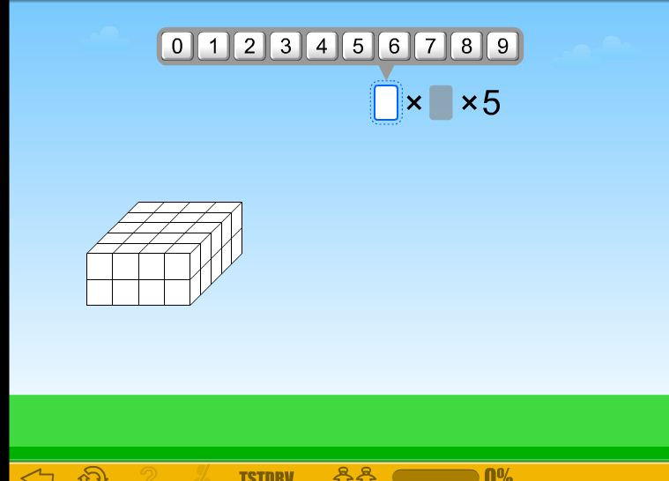
Math Talk
Take a close look.

Slide 3
Math Talk
In your head think:
What do you notice? What else do you notice?
Is this like an activity that you have done before? How is it the same? How is it different?
What does Jiji need to do?
How might you begin?
Volume
Time to Share Out!

Slide 4
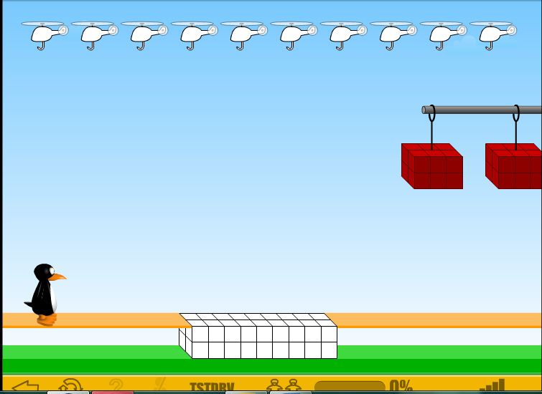
Math Talk
Time to Share Out!
Volume
I noticed that _____. Something else I noticed is _______________.
This is like ________ that I did before because ______________.
It’s different from ______ because.
Jiji needs to ________ because ___________.
I would begin by ______.

Slide 5
Math Talk
Volume
In your head think about the following
essential questions:
How can you find the volume of cubes and rectangular prisms?
Why is it important to know how to measure volume?
Time to Share Out!

Slide 6
Math Talk
Ready to try out your strategy?
St Math Teacher Login Link:
http://web.stmath.com/entrance/microtc.html#/ndl

